Slide 1
The Americans with Disabilities Act
Rights, Responsibilities, and the
Reasons They Matter

Slide 2
Definition of “disability”
Miriam-Webster.com: a physical, mental, cognitive, or developmental condition that impairs, interferes with, or limits a person's ability to engage in certain tasks or actions or participate in typical daily activities and interactions.
Dictionary.com: lack of adequate strength, or physical or mental ability.
UrbanDictionary.com: a physical or mental condition that means that you cannot use a part of your body completely or easily, or that you cannot learn easily.
Notes:
Warm up: I’d like you to think for a minute about people with disabilities. Maybe you or someone you know identifies as having a disability. Think about what you know or what you imagine about disability in everyday life. What barriers might your community, school, or workplace pose for someone with a visible disability? What about for an invisible disability?

Slide 3
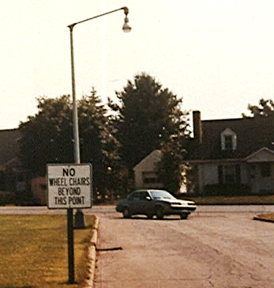
Historical treatment of people with disabilities
In the not-so-distant past, people with disabilities were shunned, misunderstood, ridiculed, or feared.
People with disabilities, especially those with intellectual and mental health disabilities, were forced to live in institutions.
Most city streets, schools, and businesses were off limits to people with physical disabilities.
The ability to talk on a telephone was impossible for those with communication disabilities.
Notes:
Image on the right: neighborhood street sign from an unidentified location captures both the depth and absurdity of public concern about people with disabilities.
Downloaded on 3/10/2023 from: https://everybody.si.edu/sites/default/files/styles/overlay/public/PL22.JPG?itok=wxO2h_Uo. From the Smithsonian’s National Museum of American History’s web exhibit entitled: “EveryBody: An Artifact History of Disability in America”.

Slide 4
Treatment of people with disabilities today
While the way we treat people with disabilities has improved and continues to improve, there’s still a long way to go.
  We assume people with disabilities can’t do the same things as people without disabilities.
  We use slang – like “neurotic,” “crazy,” and “lame” – that originate from words historically used to describe disabilities.
  We ignore the needs of people with disabilities, either intentionally or unintentionally.
  We think people with disabilities are at a disadvantage and should be pitied.
  We celebrate and praise people with disabilities who accomplish the same life goals and milestones as those without disabilities, implying that these are unusual accomplishments for people with disabilities.
“Ableism" is the name of discrimination against people with disabilities. Ableism is a set of beliefs or practices that devalue people with disabilities.
Notes:
Check in options (after reviewing the slide): Ask students to reflect on ableist statements that you might hear in the news or in day-to-day conversations with peers and then develop alternative statements. If there’s time, take it a step further by encouraging the class to develop a plan for intervening when they hear someone using ableist language. This activity could be a class discussion or written down individually and then voluntarily shared with the class.
Share the following ableist statements:
The economy has been crippled by debt.
My mom is being so crazy today.
The football game on Friday night was insane!
Don’t be blind to the suffering of others.
The president is a lame duck.
I’m so ADD today.
She’s so OCD about keeping her house clean.
That party was so lame!
Reflection prompt: What might these statements mean for people with disabilities?
Developing an alternative prompt: What could we say instead? How might we rephrase the statement without changing the meaning?
Examples of alternatives:
The economy has been severely impacted by debt.
My mom is being so bizarre today.
The football game on Friday night was intense; it was so exciting to watch!
Pay attention to how others around you are doing.
The president is a has no power for the next two years.
It feels hard for me to focus right now.
She spends so much time keeping her house clean that she doesn’t have time for fun.
That party was boring; nothing exciting happened!

Slide 5
A few disabilities that kids of all ages might have
Disabilities go beyond wheelchairs and other disability stereotypes.
Kids and teenagers can have all sorts of disabilities.
Disabilities in kids and teenagers are often invisible to friends, teachers, and even family members.
Sometimes kids and teenagers have more than one disability.
Out of every 100 kids age 3 to 17…
7 have asthma
6 have a speech or language disorder
4 have depression
9 have anxiety
8 have a learning disability
2 have autism
10 have ADD/ADHD
Notes:
A Note on Apparent and Non-Apparent Disabilities
“Invisible” is a word that many people with disabilities do not like. It is used on this slide since it is easy to understand. However, the current term for disabilities that are not physically obvious is “non-apparent”.
Data Source for the Table on the Right
2020-2021 National Survey of Children's Health Indicator 1.9: One or more current or lifelong health conditions, retrieved from childhealthdata.org.
These numbers are reported by parents. Consequently, some numbers may be higher than is reported here, especially depression and anxiety.

Slide 6




Why this matters
As you wrestle with questions about equality, it is important to think about disability issues because there are more people with disabilities than you might think.
One out of five children
has a disability
One out of four adults
has a disability
Notes:
Check in (after reviewing the slide): ask students to raise their hand if they personally know at least one person who has a disability. It could be the student, too. Does this informal poll approximately match one of these statistics? If the poll doesn’t, have the class consider whether this is because some disabilities are invisible or non-apparent.
Children with Disabilities Graphic
“Children” encompasses three-year-olds and teenagers up to and through age 17
The statistic for children is from the Children with Special Health Care Needs (CSHCN) survey from 2020-2021 data. https://www.childhealthdata.org/browse/survey/results?q=9314&r=1
The CSHCN survey is a part of a larger survey called the National Survey of Children’s Health (NSCH) which provides rich data on multiple, intersecting aspects of children’s lives—including physical and mental health, access to quality health care, and the child’s family, neighborhood, school, and social context. https://www.childhealthdata.org/learn-about-the-nsch
Adults with Disabilities Graphic
The adult data comes from the Behavioral Risk Factor Surveillance System (BRFSS) in 2020. https://www.cdc.gov/brfss/index.html
The BRFSS is a survey that collects data about U.S. residents regarding their health-related risk behaviors, chronic health conditions, and use of preventive services.

Slide 7
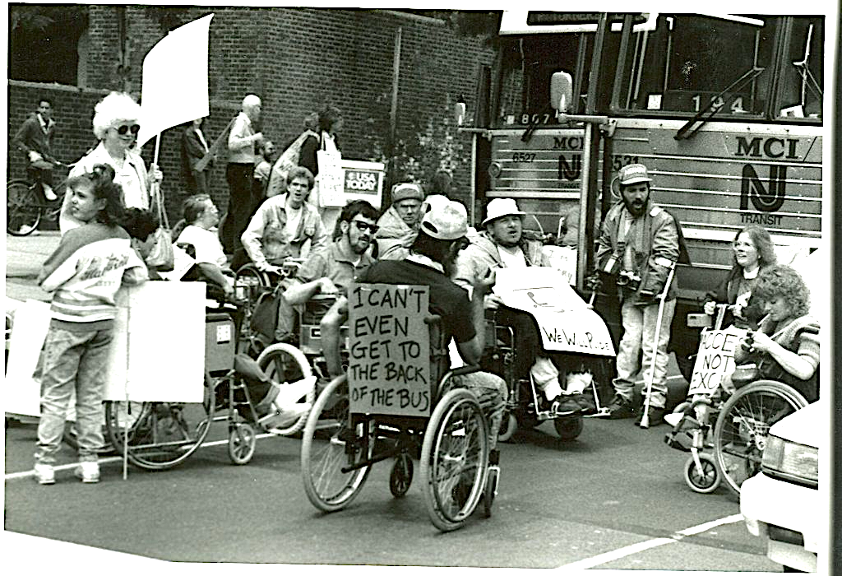
Disability rights movement
In 1964, Congress passed the Civil Rights Act. It did not include protections for people with disabilities.
Across the nation, people with disabilities and parents of children with disabilities began challenging social and physical barriers.
For decades, people protested by sitting in the lobbies of federal buildings, obstructing buses that were inaccessible to wheelchair users, and holding marches.
Notes:
Image on the right: “I can’t even get to the back of the bus”. American Disabled for Attendant Programs Today (ADAPT: adapt.org) activists protesting for accessible transportation, Philadelphia, 1990”. Credit to Tom Olin, photographer. From the Smithsonian’s National Museum of American History’s web exhibit entitled: “EveryBody: An Artifact History of Disability in America”. Downloaded on 3/10/2023 from: https://everybody.si.edu/sites/default/files/styles/overlay/public/C14.JPG?itok=8C7_vFib.

Slide 8
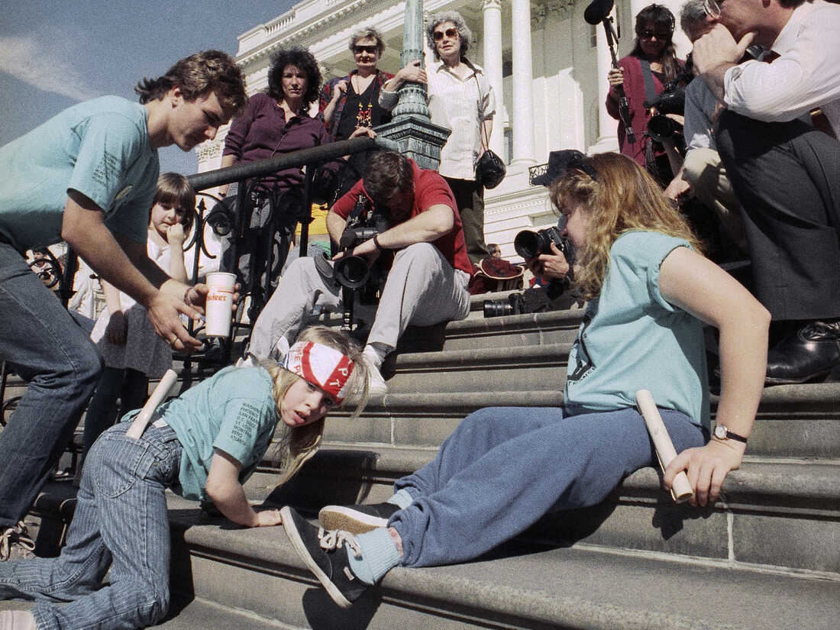
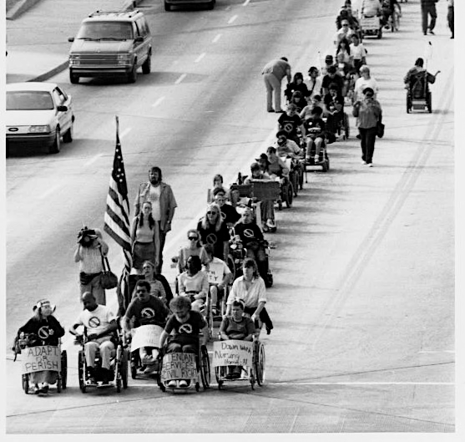
Images of the disability rights movement
Disability activists included children, Washington D.C., 1990
Disability activists blocked traffic, Atlanta, 1990.
Notes:
Image on the left: (Original caption by the AP) A group of disabled people led by 8-year-old Jennifer Keelan (left) crawl up the steps of the U.S. Capitol in Washington in March 1990 to draw support for a key bill [the ADA] pending in the House that would extend civil rights to disabled persons. Credit to Jeff Markowitz/AP. Downloaded on 3/24/2023: https://www.npr.org/2022/07/29/1113535976/ada-disabilities-act-activists-more-protections
Image on the right: ADAPT disability activists block traffic as they stream through downtown Atlanta. Credit to Tom Olin, photographer. From the Smithsonian’s National Museum of American History’s web exhibit entitled: “EveryBody: An Artifact History of Disability in America”. Downloaded on 3/10/2023: https://everybody.si.edu/sites/default/files/styles/overlay/public/C11.JPG?itok=MPyM48dT.

Slide 9
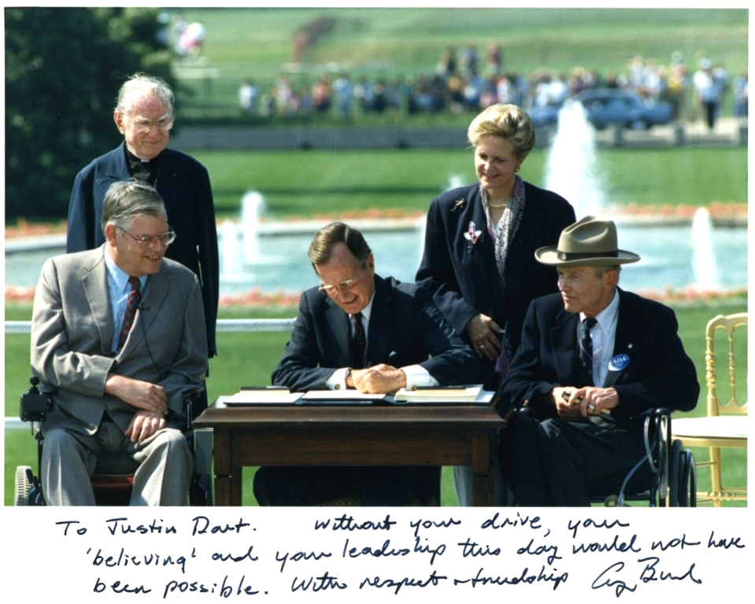
The Americans with Disabilities Act
The Americans with Disabilities Act, or ADA, is a federal civil rights law that was signed on July 26, 1990, nearly 30 years after the Civil Rights Act was passed.
The ADA gives people with disabilities protections similar to people who are protected by other civil rights laws.
The purpose of the law is to make sure people with disabilities have the same rights and opportunities as everyone else to live, work, attend school, and play.
Notes:
Upon signing the the ADA into law, George H.W. Bush said, “Three weeks ago, we celebrated our nation's Independence Day. Today we're here to rejoice in and celebrate another 'Independence Day,' one that is long overdue. With today's signing of the landmark Americans for Disabilities Act, every man, woman, and child with a disability can now pass through once-closed doors into a bright new era of equality, independence, and freedom."
Image on the left: On a beautiful sunny day on the South Lawn of the White House, President George H. W. Bush, flanked by activists Evan Kemp and Justin Dart, signs the ADA. Bush inscribed this photo to Justin Dart, noting his leadership and drive for disability rights: To Justin Dart, without your drive, your “believing” and your leadership this day would not have been possible. With respect and friendship, George Bush” From the Smithsonian’s National Museum of American History’s web exhibit entitled: “EveryBody: An Artifact History of Disability in America”. Downloaded on 3/10/2023 from: https://everybody.si.edu/sites/default/files/styles/overlay/public/C22_0.JPG?itok=LYG7g987.

Slide 10
Definition of “disability” revisited
Dictionaries’ definitions
Definition according to the ADA
Miriam-Webster.com: a physical, mental, cognitive, or developmental condition that impairs, interferes with, or limits a person's ability to engage in certain tasks or actions or participate in typical daily activities and interactions.
Dictionary.com: lack of adequate strength, or physical or mental ability.
UrbanDictionary.com: a physical or mental condition that means that you cannot use a part of your body completely or easily, or that you cannot learn easily.
A disability is "a physical or mental impairment that substantially limits one or more major life activities.”
Major life activities are basic activities (seeing, breathing, walking, hearing, speaking…) that most people can perform with little or no difficulty.
This is a legal definition specific to the ADA. Different definitions may be used in other contexts and laws.
Notes:
Physical or Mental Impairments
ADA regulations do not list all impairment, diseases, or conditions that make up "physical or mental impairments." There are so many possible impairments, it would be impossible to list them all.
Major Life Activities
Other examples of major life activities are sleeping, caring for one’s self, performing manual tasks, and working. Major life activities also include major bodily functions such as immune system functions, normal cell growth, digestive, bowel, bladder, neurological, brain, respiratory, circulatory, endocrine, and reproductive functions.
Substantial Limitations
An impairment is a "disability" under the ADA if it substantially limits one or more major life activities. A person’s ability to perform a major life activity should be compared to the ability of “most people”, but not on how disabled a person is. The focus should be on whether someone experienced discrimination on the basis of disability.
Difference in Definitions
The definition of disability is slightly different according to three other federal laws that address disability rights, including the Rehabilitation Act, the Individuals with Disabilities Education Act (IDEA), and the Air Carrier Access Act.

Slide 11
Discrimination on the basis of disability
Under the ADA, discrimination is the failure, either intentionally or unintentionally, to give a person with disabilities the equal opportunity:
To find, maintain, and benefit from employment.
To participate in or benefit from the services and programs of
state or local government.
To obtain or use the goods, services, or facilities of places that are open to the general public, which includes most businesses.
Discrimination is the unfair or prejudicial treatment of people based on personal characteristics.
Though many people are not aware of discrimination based on disability, it does occur and is damaging to those who experience it. This type of discrimination is called “ableism.”

Slide 12
Even if you don’t have a disability, you can still experience ableism
You are protected from discrimination if you are “regarded as” having a disability.
You are protected from discrimination if you have a “record of” a disability.
A teenager at a summer camp has a slight limp because one leg is shorter than the other. Even though her limp does not substantially limit the teenager’s ability to walk, staff did not allow her to go on a hike. This is discrimination because she is being treated as though she has a disability.
A man with cancer in remission is up for a promotion at work. His bosses decide not to give him the promotion because they worry he won’t be able to do the job if his cancer returns. In other words, he is being discriminated against because he used to have a disability and doesn’t anymore.
The ADA also protects friends and family members of people with disabilities if they experience discrimination based on their relationship with a person with a disability.
Notes:
Discrimination Based on Relationships or Associations with People with Disabilities
The ADA also makes it unlawful to discriminate based on a person’s relationship with a person with a disability on the assumption that their relationship to a person with a disability would have a negative affect. This type of discrimination is often caused by bias or misinformation concerning certain disabilities. The relationship does not have to be a family member.

Slide 13
Where the ADA applies
The ADA prohibits discrimination in many aspects of public life.
Employment.
Education (from kindergarten to universities).
Voting and elections.
Court houses and driver’s license offices.
Transportation (taxis, public buses, Greyhound, limos, Amtrak, and more).
Parking lots, sidewalks, and crossing signals.
Public parks and swimming pools.
Youth summer camps and sports programs.
Health care services and offices.
Law offices and legal services.
Homeless shelters and food banks.
Hotels, restaurants, and bars.
Grocery stores and shopping malls.
Daycares.
Movie theaters and bowling alleys.
Amusement parks and concert venues.
Libraries.
Fitness clubs and gyms.
And many more.
Notes:
Other ADA Guidance
In addition to addressing disability-based discrimination, the ADA also provides guidance related to telephone and television access for people with hearing and speech disabilities, including Closed Captioning requirements for public service announcements. Closed Captioning is when spoken or audible text is displayed on a tv screen. (See slide 32.)

Slide 14
The rights of people with disabilities are protected in employment
Getting, keeping, and doing well in a job isn’t limited to applying for a job and working hard. There’s more to employment, like:
  Job application and interviewing processes and procedures.
  Hiring and firing.
  Job promotions.
  Compensation (pay and benefits like health insurance).
  Job training.
  Social activities, such as office or holiday parties.
Disability-based discrimination can and does happen to people in all aspects of employment.
The ADA gives people with disabilities access to the same employment opportunities available to people without disabilities.
Notes:
This is the beginning of the Title I section, which covers employment and all practices related to employment.

Slide 15
Employers’ responsibilities
With a few exceptions, employers with 15 or more employees must comply with the ADA. An employer covered by the ADA:
MUST ensure job qualifications are necessary and do not screen out people with disabilities, either intentionally or unintentionally.
MUST NOT ask job applicants medical or disability related questions before a job offer.
MUST, in most situations, provide reasonable accommodations to qualified job applicants or employees.
Notes:
Employers with Fewer than 15 Employees
Some state and local laws address the rights of people with disabilities when employers have fewer than 15 employees. These laws supersede the ADA.
People with disabilities who are employees of state and local governments, regardless of the size of the public entity, have the right to reasonable accommodations.
Employees of Federal Agencies
The ADA does not address the responsibilities of federal employers to provide reasonable accommodations or any other right for people with disabilities. Federal agencies and their contractors are covered by section 501 of Rehab Act which has nondiscrimination requirements as well as affirmative employment requirements.
Employers that are Exempt from Title I of the ADA
Private employers with fewer than 15 employees.
Corporations fully owned by the U.S. government, like the Federal Deposit Insurance Corporation (FDIC) and the U.S. Postal Service.
Federally recognized American Indian or Alaska Native tribal entities.
Bona fide private membership clubs that are not labor organizations and who are tax exempt. Examples: country clubs, amateur sport clubs, and homeowners associations (HOAs).
U.S. government executive branch agencies, including the President, Vice President, the Cabinet, Executive Departments, independent agencies, and other boards, commissions, and committees. (They are covered by the Rehab Act which has nondiscrimination requirements as well as affirmative employment requirements.)

Slide 16
Employees’ rights
If an applicant or employee has a disability and is qualified to do a job, the ADA protects them from discrimination.
To be qualified, the person with a disability must be able to perform the essential functions of the job, with or without a reasonable accommodation.
Essential functions are the reasons why the job exists. They are the major tasks performed by the qualified applicant or employee.
A reasonable accommodation is any change in the work environment or in the way things are usually done to help a person with a disability.
Notes:
Marginal Functions:
When a task is not fundamentally necessary to the performance of a particular job, it will be deemed as a “non-essential” or “marginal” function. Reasonable accommodations only apply to the essential job functions, not the marginal functions.
Reasonable Accommodations
A reasonable accommodation is any modification or adjustment to a job or the work environment that will enable an applicant or employee with a disability to participate in the application process, to perform essential job functions, or to enjoy the privileges and benefits of employment.
Direct Threat
The employer does not have to hire or continue to employ an individual if they cause a “direct threat” to the health and safety of the individual, or to others, when a reasonable accommodation cannot be used to eliminate or reduce the risk.

Slide 17
Reasonable accommodations
Reasonable accommodations can and should be implemented, when needed, in all aspects of employment. Including:
Applying for a job, like moving an interview for an applicant who uses a wheelchair from the second floor of a building without an elevator to the first.
Accessing all aspects of the workplace, like installing a ramp into a staff break room so that an employee in a wheelchair can enter it OR providing a voice activated headset to an employee without arms so that they can use the phone.
Performing the duties of a job, like providing screen reading software so that an employee with vision loss can read and write emails on their computer.
Enjoying the privileges of employment, like hosting the annual employee dinner at a restaurant without stairs so an employee with a mobility impairment can attend.
Notes:
Reasonable Accommodations
A reasonable accommodation is any modification or adjustment to a job or the work environment that will enable an applicant or employee with a disability to participate in the application process, to perform essential job functions, or to enjoy the privileges of employment.
Other Privileges of Employment:
Health insurance
Training and skill development
Transportation between job sites (if provided to employees)
Promotions and advancement
Access to onsite gyms and/or athletic club memberships (if provided by employees)

Slide 18
Reasonable accommodation examples
Allowing an employment specialist to assist a person with an intellectual disability in an interview and while learning how to do their job.
Reassigning marginal tasks, like light office cleaning or lifting the occasional package, for an employee with severe, chronic back pain to other employees in similar job roles.
Providing training materials in audio format for an employee with a learning disability.
Providing reserved parking for an employee with limited ability to walk long distances.
Changing a work schedule so an employee with a mental health condition can attend recurring therapy appointments.
Providing a sign language interpreter for a Deaf employee at meetings and events.
Notes:
Check in (after reviewing slide): can you think of other accommodations that an employer could make?
The possibilities are endless, but here are several to choose from to share with the class if they are stumped:
Providing adaptive computer equipment or software, like speech to text software or voice recognition software, so that an individual with quadriplegia can access and effectively use their computer
Using online application systems that are accessible to screen reading software so that blind individuals can access them
Providing training materials in picture format for an employee with a learning disability
Allowing an employee with ADHD to use a white noise machine in their cubicle
Providing job performance feedback in writing, rather than verbally, for an employee who communicates better through written materials
Changing a “no animals” policy in order to welcome an employee’s service animal
Developing a checklist to ensure task completion for an employee who has an intellectual disability
Providing ergonomic workstations, like sit-stand desks, so that an employee with chronic pain has the flexibility to sit or stand as needed
Using web-based meeting platforms that provide closed captions or live transcription for videoconferences
Reassigning an employee with a disability to an open position that they are qualified for when the employee is no longer able to perform the essential functions of the current job

Slide 19
Reasonable accommodation process
2
Request
3
Provide disability info
4
Explore and choose
5
Implement
6
Monitor usefulness
1
Realize need
Identify the need for reasonable accommodations.
Disclose a disability, explain that it is impacting their ability to interview or work, and request an accommodation.
Provide documentation if needed.
Work together to determine a reasonable accommodation that is effective for everyone.
Put the reasonable accommodation in place, maintaining confidentiality.
Evaluate the reasonable accommodation’s effectiveness.
Reasonable
Accommodation
Process
Notes:
Scenario: Fatima is an employee with epilepsy who works in a retail position at a large department store in her local mall. She has a seizure only every once in a while. She doesn’t currently have any reasonable accommodations since she feels she can do her job effectively and safely without one. Fatima recently started taking a new seizure medication which is making it difficult to wake up and she has been late three days in a row. Fatima doesn’t want to disclose her medical condition, but she also doesn’t want to get written up by her supervisor for being tardy. She’s thinking about asking for a flexible schedule so she can adjust to the new meds.
Discussion Questions (after reviewing slide): What should she do? What are her employer’s responsibilities if Fatima tells them about her disability and the impact it’s having on her ability to get to work on time? In Fatima’s situation, is a flexible schedule a reasonable accommodation under the ADA? Does the employer have to grant the reasonable accommodation? Are there alternatives?
This is the last Title I Employment slide and would be a good chance to administer the true/false quiz: The ADA in employment.

Slide 20
The rights of people with disabilities are protected in state and local governments
All around the U.S., public entities offer programs, services, and activities to community members, including:
Public schools, colleges, and universities.
Voting and government elections.
Health, police, and fire departments.
Parks and recreation services.
Street and crosswalk management.
Transportation services (including public transportation).
Under the ADA, state and local governments, which are public entities, must ensure equal opportunity for people with disabilities to participate in or benefit from all programs, services, and activities offered.
Notes:
This is the beginning of the Title II section, which covers the responsibilities of state and local governments.
Discussion prompt (after reviewing slide): Based on what we know about the programs, services, and activities of state and local governments, what do you think discrimination looks like for community members with disabilities?

Slide 21
State and local governments’ responsibilities
Make reasonable modifications to their policies, practices, and procedures. Examples:
  Allowing service animals in public spaces, including on the decks around public pools.
  Extending test time for college students who attend public colleges or universities.
Provide an auxiliary aid or service to enable people with disabilities to participate fully in the exchange of information, for free. Examples:
  Exchanging hand-written notes with a Deaf parent to communicate about his child’s experience at a public park.
  Allowing a qualified reader and note taker to assist a person who is blind during a court session.
  Offering tax forms to people with vision impairments in a form that is usable, like large print text, Braille, or electronic formats.
Notes:
Fundamental Alterations
A public entity is not required to make a modification if it can demonstrate that a modification would fundamentally alter the nature of its service, program, or activity.
A Note on Public Accommodations
Public accommodations (or private businesses) have similar rules to follow regarding reasonable modifications and auxiliary aids and devices. See slide 28, “Reasonable modifications”, and slide 29, “Public accommodations must ensure effective communication”.

Slide 22
Responsibilities continued: Ensure access
State and local government must make programs, services, and activities accessible. Examples:
  A city hall that only has stairs to their entryways installs ramps for people with mobility disabilities.
  A community college counselor who meets with students in a private office on the third floor of a building without an elevator uses an accessible location on the ground floor as long as it offers the same degree of privacy.
  A historical building with a second story that is inaccessible creates a virtual tour of the second story.
Newly constructed buildings or buildings undergoing renovations must have accessible restrooms, accessible signs, accessible parking spots, and accessible entrances.
  Rules about historic buildings are more complicated and decisions are made on a case-by-case basis.
Notes:
Scenario: Your best friend’s 8-year-old sister, Charmaine, has cerebral palsy and uses a wheelchair to get around. During dinner with your best friend’s family, their mom told a story about how Charmaine was invited to go to a birthday party at a local public park earlier in the day. She said Charmaine was super excited, but when it came time to hang out with her friends on the playground, her chair could not pass over the high cement border surrounding it. There were no cutouts or ramps to allow a wheelchair to enter the playground. Charmaine was bummed and their mom didn’t know what to do, so they left early. Charmaine missed out on the chance to play with her friends.
Discussion Questions: What are Charmaine’s rights? Who might Charmaine’s mom talk to so that Charmaine can play on the playground with her friends in the future? What solutions could be implemented to give Charmaine access to the playground? Would any of these solutions benefit other people as well? In what ways?

Slide 23
Community members’ rights
People with disabilities are entitled to participate in the same programs as all others, even if:
The public entity reasonably believes the person cannot benefit from the program.
A blind individual must be allowed to visit a public museum, even if the majority of the art is visual. Audio descriptions of the art can be provided to offer equal opportunity to enjoy the exhibits.
The public entity provides a separate program for individuals with disabilities.
The local parks and rec department offers an adaptive yoga class for people with disabilities. A woman with cerebral palsy must be allowed to participate in the general yoga class if she desires.
Notes:
Direct Threat
People with disabilities must not be excluded from participation in services, programs, or activities, unless there is a “direct threat.” An individual with a disability may be excluded if they pose a direct threat to the health or safety of self or others that cannot be eliminated or reduced to an acceptable level by making modifications or by providing auxiliary aids or services.

Slide 24
Rights continued: Effective communication
It is difficult for anyone to participate in their community if they cannot understand what is being communicated.
  People with disabilities have the right to effective communication, whether it is direct communication between people, printed materials, or information being shared online.
  Auxiliary aids and services must be provided for free upon request to facilitate effective communication.
  Information published on websites run by public entities must be accessible to users with disabilities. These websites allow community members to have easy and convenient access to the programs, services, and activities of state and local government entities.
Notes:
Auxiliary Aids and Services
Examples of effective communication through aids and services are on slide 29, “Public accommodations must ensure effective communication”. These examples are for public accommodations (private businesses), which have similar rules as state and local government entities to provide effective communication to their customers. The auxiliary aids and services described on slide 29 would be the same for state and local entities. An additional example is on slide 21, “State and local governments’ responsibilities”.

Slide 25
State and local government websites
The ADA was passed at a time when most of the world did not have access to the internet, let alone personal computers, so the ADA did not address web accessibility…
However, state and local governments must still provide fully accessible websites. Otherwise, they are denying people with disabilities equal access for activities like:
Registering for classes at a state college
Filing taxes
Paying fines and tickets
Applying to social service programs
Renewing state-issued ID cards
Applying for an absentee ballot
Notes:
Computer Access for People with Disabilities
People with disabilities navigate the web and control their computers in a variety of ways.
People who are blind may use screen reading software that speaks the text on a screen and provides page navigation tools.
People who are deaf may use closed captioning for videos.
People who have difficulty using a mouse or trackpad may use voice recognition software to control their computers with verbal commands.
People who have certain learning disabilities may use specialized software to read and write. Text to speech software, which reads text out loud, can be used to read webpages and documents. Speech to text software, which types out what is spoken, can be used to write emails or documents, like essays, for example.
Web Accessibility for Businesses
Whether ADA applies to private businesses, which are covered by Title III rather than Title II, is a little unclear when it comes to their websites. This includes businesses that are (primarily) online shopping websites. These businesses can utilize standards like the Web Content Accessibility Guidelines (WCAG) in order to meet the spirit of the ADA and provide access to digital information, so that people with disabilities may have equal opportunity to participate in and benefit from the services, activities, and goods offered to all customers, patrons, or clients.

Slide 26
The rights of people with disabilities are protected in businesses that are open to the public
Every day, people living in the U.S. visit:
Hotels and restaurants.
Movie theaters and amusement parks.
Convention centers.
Doctors' offices and lawyers’ offices.
Grocery stores, pharmacies, and shopping malls.
Banks and libraries.
Private schools and day care centers.
Homeless shelters.
Fitness gyms and health spas.
Companies offering educational testing.
These businesses are examples of places of public accommodation that are open to the public.
Public accommodations must ensure that people with disabilities have equal opportunity to participate in and benefit from the services, activities, and goods offered to all customers, patrons, or clients.
Notes:
This is the beginning of the Title III section, which covers the rights of people with disabilities to have equal opportunity to enjoy the goods, services, and facilities of public accommodations.
Discussion prompt (after reviewing slide): What do you think discrimination could look like when people with disabilities enter or interact with businesses? How might a private business address this?

Slide 27
Public accommodations’ responsibilities
To ensure that people with disabilities have equal opportunity to use and access the goods, services, and facilities of public accommodations, businesses and non-profits must:
Make reasonable modifications in policies, practices, and procedures.
Ensure
effective communication.
Remove physical barriers to create accessible facilities.
Notes:
Direct Threat
People with disabilities must not be excluded from participation in services, programs, or activities, unless there is a “direct threat.” An individual with a disability may be excluded if they pose a direct threat to the health or safety of self or others that cannot be eliminated or reduced to an acceptable level by making modifications or by providing auxiliary aids or services.

Slide 28
Reasonable modifications
Public accommodations must make reasonable modifications in policies, practices, and procedures that deny equal access to people with disabilities.
  A movie theater must modify their policy of allowing movie-goers to sit anywhere they choose by asking them to move to another seat to allow wheelchair users and their companions to sit next to each other.
  A restaurant owner must modify a “no pets” policy to allow a person with diabetes who uses a service animal to dine in the restaurant alongside all other customers.
  A bookstore that only carries standard print size books must order large print books for an individual with a significant vision impairment, if the store regularly makes other special orders for non-stocked goods and the large print books are available from the store’s regular suppliers.
Modifications to policies, practices, and procedures that make fundamental changes to the very nature of the goods, services, or activities are not required.
Notes:
Fundamental Change Example
A planetarium is not required raise the lights of the stars and planets viewing room so a man with low vision can read the large print program provided. However, the planetarium has an obligation to provide effective communication which could be accomplished by offering him a clipboard with an attached reading light.
A Note on State and Local Governments
State and local governments have the same rules to follow regarding reasonable modifications and auxiliary aids and devices. See slide 21, “State and local governments’ responsibilities”.

Slide 29
Public accommodations must ensure effective communication
Communication with people who have disabilities must be as effective as it is with others, which may include providing auxiliary aids and services, for free, to eliminate communication barriers.
At a car dealership, a Deaf person who uses sign language can often communicate with the sales staff about general information via cell phone texts or written notes. If they become serious about buying a car, a qualified ASL interpreter may be necessary because of the complicated nature of the communication involved in buying a car.
If a person who is blind is going to sign important sales documents at a real estate office, staff may need to email an electronic version of the documents so the person can use text-to-speech technology to read the paperwork in advance.
A movie theater keeps assistive listening devices for people with hearing impairments to use for free while watching a movie.
A restaurant does not need to keep large print or Braille menus on hand for people with vision impairments, so long as the restaurant provides menus in digital formats or a restaurant employee can read the menu to the customer.
Notes:
ASL
This is an abbreviation for American Sign Language.
A Note on State and Local Governments
State and local governments have similar rules to follow regarding auxiliary aids and devices. See slides 21, “State and local governments’ responsibilities”, and slide 24, “Rights continued: Effective communication”.
Scenario: Tom was born deaf and has lived most of his life in the Deaf community using American Sign Language (ASL) to communicate. He recently developed severe pneumonia and was admitted to a private hospital. Through the exchange of handwritten notes, Tom has been requesting an ASL medical interpreter, but the hospital keeps telling him that he’ll be charged the fee of hiring one. Tom keeps insisting that it’s the hospital’s responsibility to pay for an interpreter.
Discussion Questions (after reviewing the slide): According to the ADA, who is right? Can you think of alternatives to an ASL interpreter? If you can, given the complicated nature of medical information, would the alternatives be appropriate?

Slide 30
Accessible facilities
Public accommodations must remove physical barriers in existing facilities when it is easily accomplished, meaning without much difficulty or expense.
  A restaurant rearranges their dining floor to allow a person in a wheelchair to dine with their family.
  A cheese factory, who offers tours to the public, removes barriers along the tour route, like large containers partially blocking walkways.
Public accommodations must provide alternatives to barrier removal when modifications cannot be easily accomplished or are too expensive for the business.
  A hotel provides clipboards for guests in wheelchairs to sign check-in documents and pay bills.
  A restaurant with several steps leading to its entrance determines it cannot afford to install a ramp. Instead, the restaurant provides its services by providing takeout service and outside dining.
Public accommodations must provide accessibility in all renovations or additions to facilities and in the construction of new facilities.
  This includes accessible restrooms, signs, parking spots, and facility entrances.

Slide 31
Examinations and courses
Businesses that offer certain exams and courses related to education and occupational certification must, if needed and requested:
  Provide reasonable modifications to policies, procedures, and practices.
  Ensure effective communication, which may include providing auxiliary aids and services for free.
  Offer examinations and courses at accessible locations and in formats that are accessible.
Some of the examinations covered include:
  School admission exams (like private high school entrance exams) and college admission exams (like the SATs or the ACTs).
  Examinations for admission to trade or professional schools.
  Bar exams for lawyers and board exams for medical licenses.
Advance notice of modifications or aids needed may be required.
Documentation of a disability may be requested.

Slide 32
Telecommunications
The ADA addresses telephone and television access for people with hearing and speech disabilities, including:
Closed captioning of federally funded public service announcements (PSAs) is required. Closed captioning displays the audio portion of PSAs as text on the TV screen. This provides Deaf people with important access to information shared by federal agencies.
Telecommunications Relay Service (TRS) for local and long-distance telephone calls must be offered by telephone companies. TRS uses operators to assist with telephone calls between people with hearing and/or speech disabilities and other individuals. There is no cost to use TRS.
Notes:
This is the slide for Title IV.
Additional Information
More information about closed captioning: https://www.fcc.gov/consumers/guides/closed-captioning-television
More information about TRS: https://www.fcc.gov/trs

Slide 33
General rules
The ADA has several technical statements that apply to all elements and regulations of the ADA. Examples:
The ADA prohibits retaliation, intimidation, or interference with people exercising their rights.
The law similarly protects people who encourage or aid others in achieving their rights. (It is important that people without disabilities are protected if they provide support, like speaking out on behalf of people with disabilities.)
The ADA does not override any other laws (federal, state, or local) that provide equal or greater protections or possible legal solutions for people with disabilities. The law that provides more protection to a person with disabilities should be followed first.
Notes:
This is the slide for Title V.
An Additional Stipulation that May Be Worth Discussing
The ADA does not consider sexual orientation to be a disability. However, it is important to note that a person who is transgender, for example, and uses a wheelchair would be considered a person with a disability.

Slide 34
Disability rights laws that apply to school settings
The ADA
  The ADA applies to pre-schools, K-12 schools, and postsecondary settings (colleges, universities, trade schools, etc.)
  The way the ADA applies to school settings vary, depending on if the school is public or private.
  Religious schools or entities controlled by religious organizations are generally exempt from the ADA.
Individuals with Disabilities Education Act (IDEA)
  IDEA ensures special education and services for children and youth with disabilities. Under this law, “individualized education programs,” commonly called IEPs, are established to provide specialized instruction and/or supports in public K-12 settings.
Rehabilitation Act of 1973 (Rehab Act)
  Section 504 of the Rehab Act applies to school districts and higher education institutions if they receive federal financial assistance. Under this law, a 504 plan may be established when the student does not require specialized instruction but does need equal access to public education.

Slide 35
Examples of ADA implementation in schools
Antony, an 11-year-old with epilepsy, has a service animal named Oscar, who is trained to alert Antony to oncoming seizures. Antony is starting a new school and when his parents enroll him, they tell the elementary school that Antony will be bringing Oscar to school. As a modification to school district policies, his new elementary school allows Oscar to accompany Antony everywhere he goes.
Barret is a 7th grader who uses a cochlear implant to hear. Even with his cochlear implant, Barret cannot hear everything and uses lip reading and educated guesses to fill in the gaps. It is especially difficult for Barret to hear what is being said at school assemblies, so his school agrees to provide Communication Access Realtime Translation (CART), a service that displays words on a large screen as they are spoken, during the assemblies.

Slide 36
A few more examples of ADA implementation in schools
Mariah has diabetes. She needs to be able to take her shots and eat snacks at certain times of the day. Her high school makes a reasonable modification to their attendance policy to allow Mariah to be a few minutes late to class or leave class when needed for this reason.
Lily, a high school student with a heart condition that substantially limits several major life activities, has an an ongoing schedule change as a reasonable modification so she may attend monitoring appointments from a health care provider every other Friday afternoon.
Charley is a freshman at a state university who has a learning disability. Through the university’s disability services office, Charley requested and received an accommodation for extra time on all testing activities intended to be completed in a single class session, including quizzes, midterms, and final exams.

Slide 37
Ensure your rights are respected
Ensuring your rights are respected under the ADA sometimes requires action.
  For employment rights, talk to your HR representative or a supervisor first.
  For disability rights in high schools or college campuses, try talking to your guidance counselors or disability services offices on college campuses.
  In state and local governments, you can reach out to their ADA Coordinators who help make sure the ADA is being followed. You can usually find out who this person is on government entities’ websites.
  In businesses, or “public accommodations” as they are known under the ADA, sometimes it’s enough to request the changes you need by talking to someone in charge, like a manager or owner.
Regardless of the steps you take, document everything. Send yourself a text message or an email to record the conversation you had or the action you took. Remember to include dates, names, and any suggested or planned next steps.
Notes:
Wrap-up: I’d like you to reflect on our opening question about the barriers that might exist in your community, school, or workplace for someone with a visible or invisible disability. Do you feel better able to address those barriers if you need to? What is one step you could take to ensure your rights, or those of a friend or family member, are respected?
A Note on Enforcement
While there is no one enforcement agency, there are many federal government departments that oversee the rules and regulations of the ADA. Complaints are often resolved through mediation; sometimes legal action is taken. Usually, resolutions do not lead to money being awarded to the person making the complaint. Also, since the ADA is a civil rights law, there is no enforcement agency to make sure discrimination against people with disabilities does not happen in the first place.
Information About Other laws
The Air Carrier Access Act prohibits discrimination on the basis of disability in air travel and applies to all U.S. airlines. It also applies to flights within, to, or from the United States by foreign airlines. Airport terminals on U.S. soil are covered by the ADA.
The Fair Housing Act is a federal law that protects a person with a disability, among other protected classes of people, from discrimination in obtaining housing, financing for housing, or housing assistance. Under this law, a landlord or homeowner’s association must provide reasonable accommodations to their policies so that people with disabilities have equal housing opportunities and to permit people with disabilities to make reasonable modifications, like installing shower grab bars, to their units or common areas.
States and local governments may have additional laws addressing the rights of people with disabilities, similar to the ADA. For example, some states have laws that apply to employers with fewer than 15 employees. If a state or local law provides more protections to people with disabilities, it must be followed before the ADA.

Slide 38
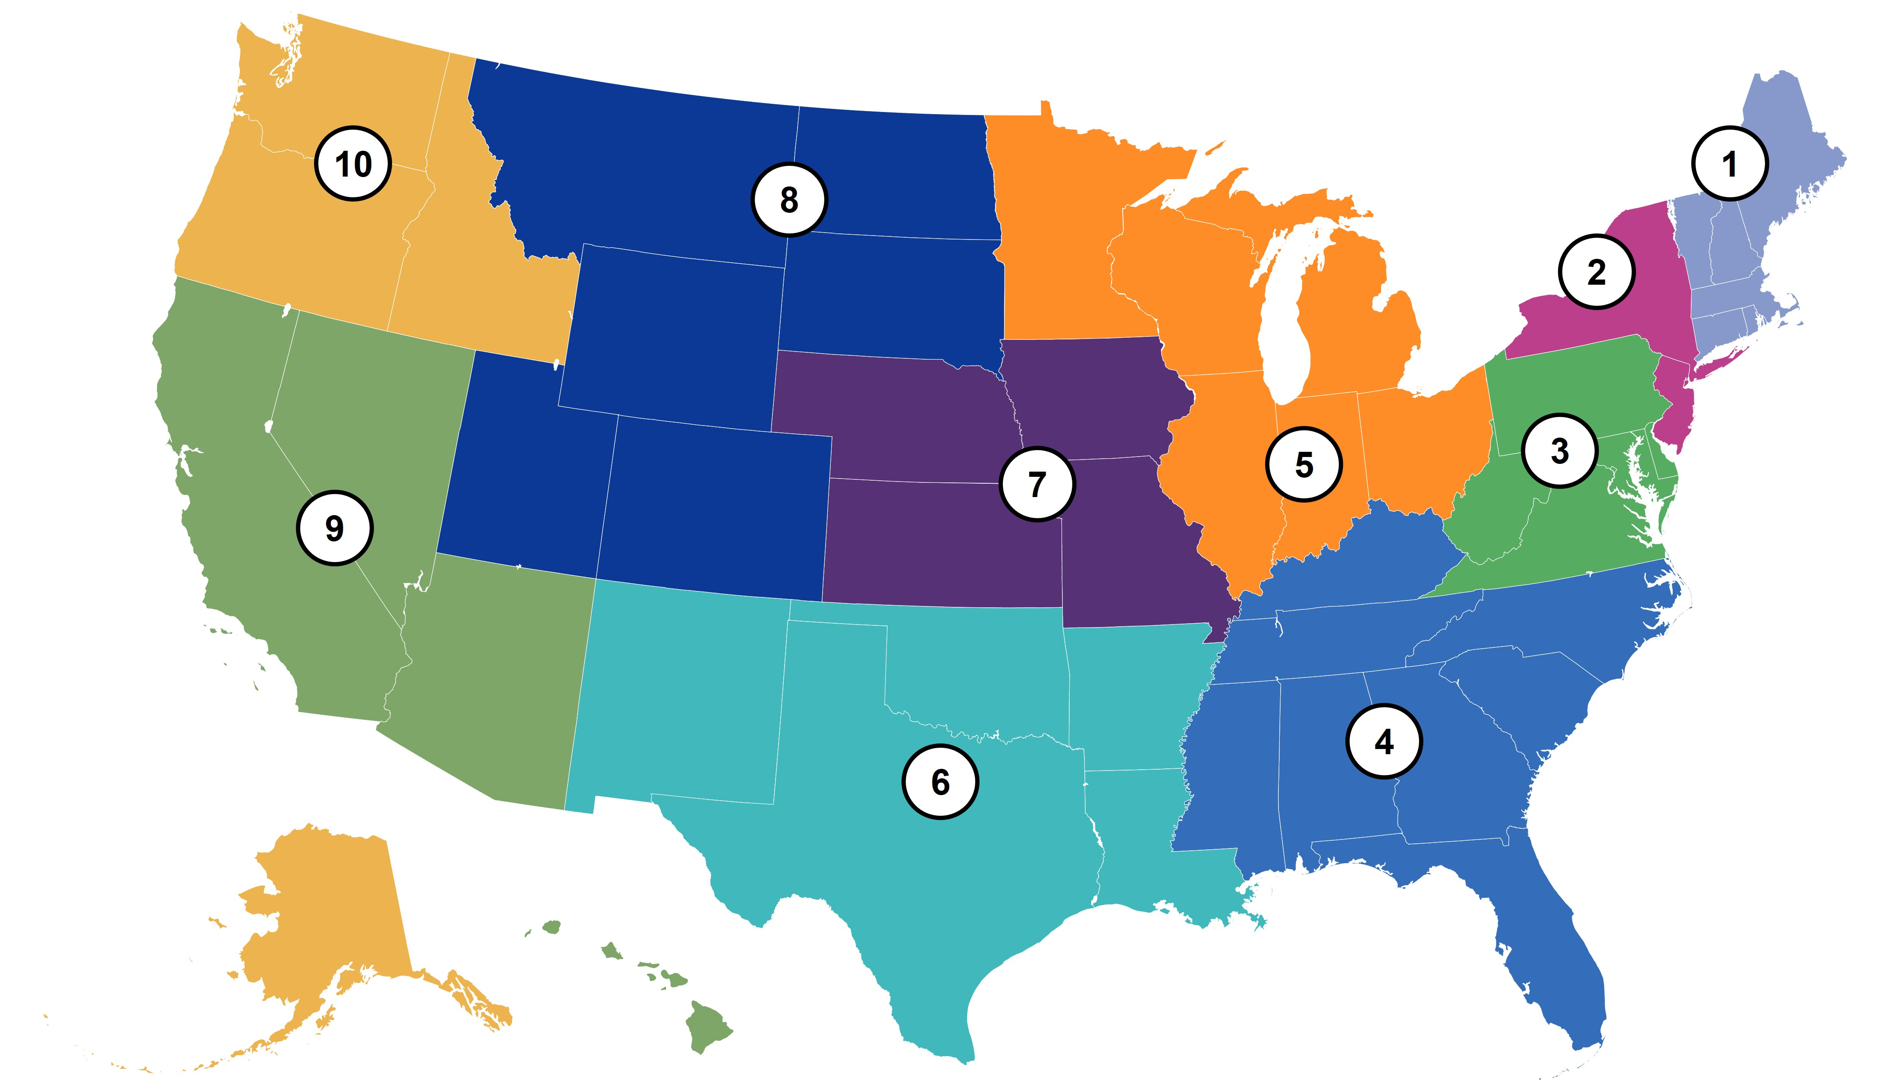
Get advice and additional resources
Check out the Find Your Region page on the ADA National Network website
Each U.S. state and territory has a regional ADA Center that can provide advice and resources on all aspects of the ADA and answer questions about your circumstances.
If you are unsure if the ADA applies to your situation, the ADA Centers can help figure that out.
Regional ADA Centers can also provide information about legal steps to take, including which federal departments to contact to file complaints.
Notes:
ADA National Network Information
The ADA National Network provides information, guidance and training on how to implement the ADA. The ADA National Network serves everyone, including businesses, employers, state and local governments, architects, disability organizations, and people with disabilities whose rights are protected under the ADA. Through telephone calls, emails, and in-person consultations, ADA specialists address questions on a wide range of topics such as reasonable accommodations at work, how the ADA applies to students in post-secondary school settings, and transitioning from school to work. They may also be able to address questions about other disability laws.
Find your region link: https://adata.org/find-your-region
ADA National Network website: https://adata.org/

